Slide 1
Quotation system

Slide 2
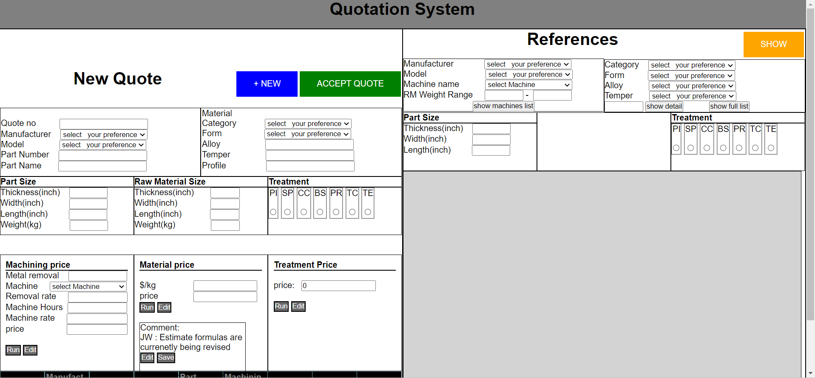
Home page

Slide 3
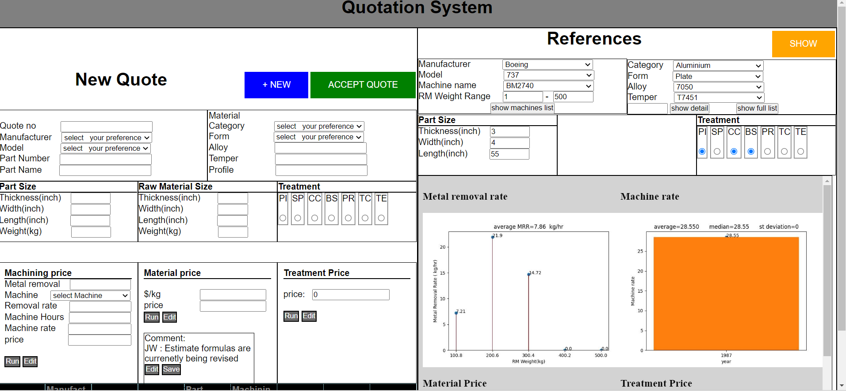
Input References with Histogram1 , Histogram2

Slide 4
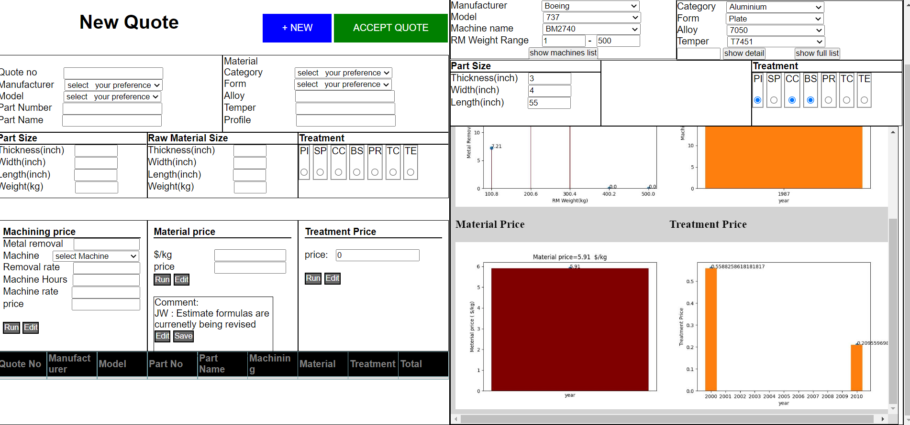
Histogram 3 and Histogram 4

